Slide 1


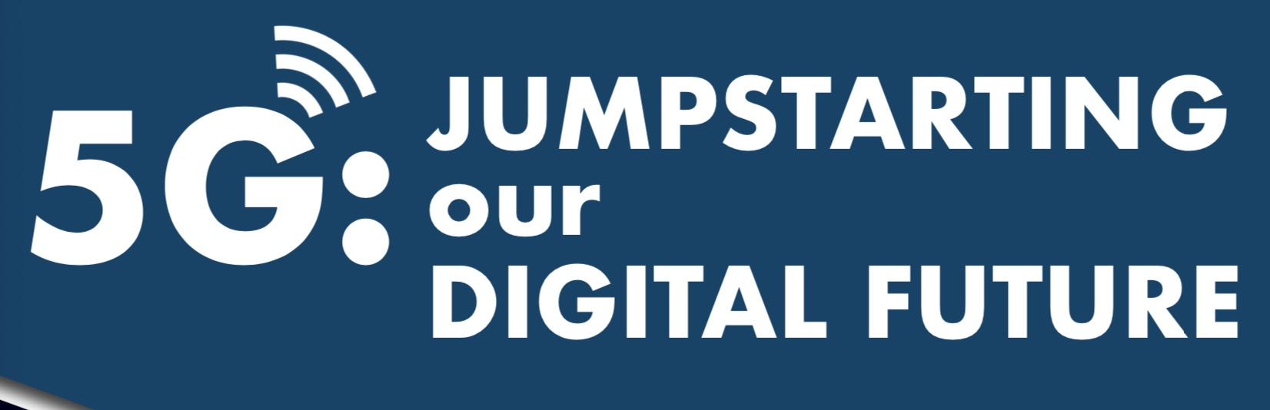

Slide 2
Introduction
“5G telecommunications technology”
Technologies of 5G
Timeline of Rollout

Slide 3
Potential Impact of 5G on Business
Healthcare & AR/VR via 5G
Ag-tech & IoT via 5G
Manufacturing and 5G
Jobs & Skills

Slide 4
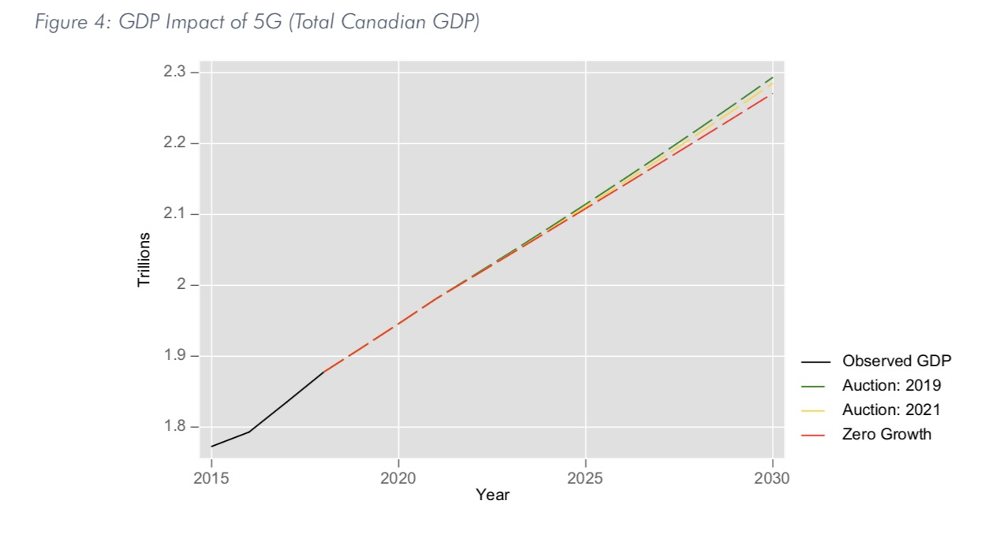
5G Economic & Labour Forecasts

Slide 5
Conclusion
5G is so much more than just the next generation of mobile Internet.

Slide 6
Thanks for watching

